Slide 1
Presentation Outline
1- Project description
2- HPLC method: preparation of standards, separation of metabolites, retention time
3- Analysis of glycerol samples:
3.1) Tech grade glycerol 3.2) Crude glycerol 3.3)Glycerol pitch
4- S.cerevisiae: pathway from glycerol to succinate
5- Y. lipolytica: pathway from glycerol to glyoxylate

Slide 2
Project Description
Huge rise in the price of petroleum and environmental concerns
Biodiesel is an alternative with crude glycerol as a byproduct
Tremendous increase in the production of crude glycerol and huge decline in its price
Conversion of crude glycerol into valuable organic acids
Enhance economic viability of biodiesel industry

Slide 3
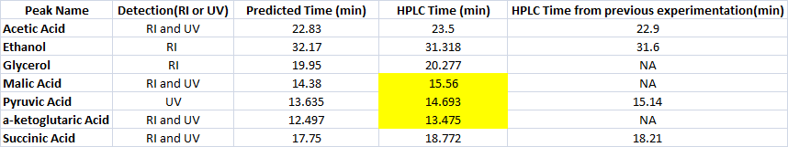
Choosing Optimal HPLC Method
Retention time: Separation of important metabolites
HPLC Method: Eluent :5mM H2SO4,
Column temperature : 36C,
Flow rate :0.4ml/min,
Run time: 35min

Slide 4
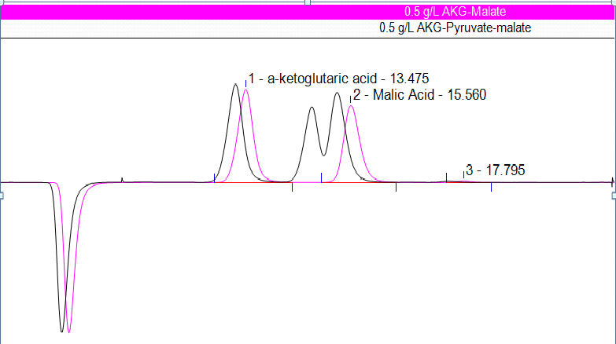
Interference of AKG-Malate-Pyruvate

Slide 5
Standards: Glycerol

Slide 6
Analysis of Glycerol Samples:
1) Technical Grade Glycerol : 91.51% glycerol
2) Crude Glycerol : 60.85% glycerol
3) Glycerol Pitch : 62.04% glycerol

Slide 7
S. cerevisiae: Pathway from Glycerol to Succinate
Growth of S. cerevisiae (CEN.PK113-1A) on glycerol :
Wild Type : Low rate of growth, Low glycerol consumption
Negligible effect of temperature and amino acids on growth
No growth in anaerobic conditions on glycerol
significant amounts of biomass produced, low concentration of organic acids produced

Slide 8
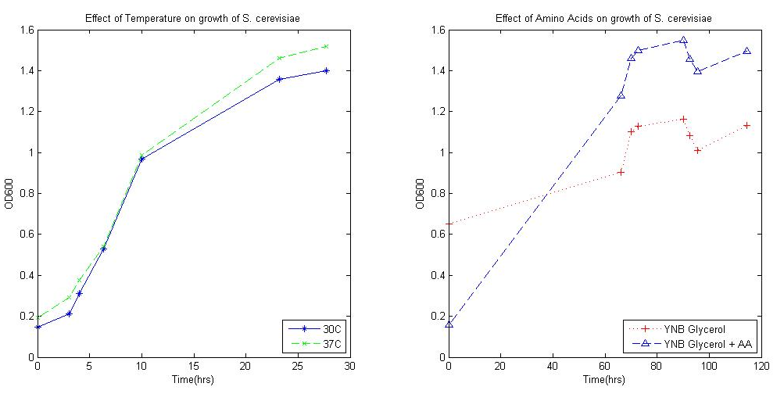
Effect of Amino Acids and Temperature on Growth

Slide 9
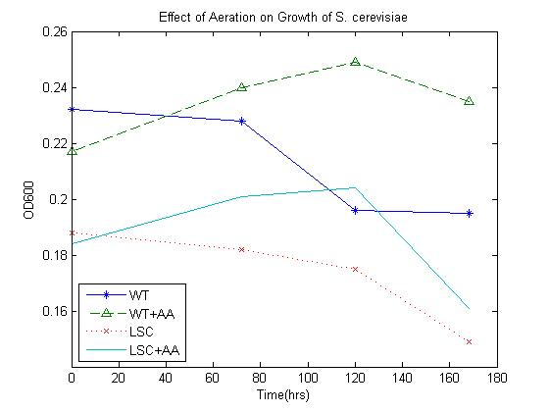
Effect of Aeration on Growth

Slide 10
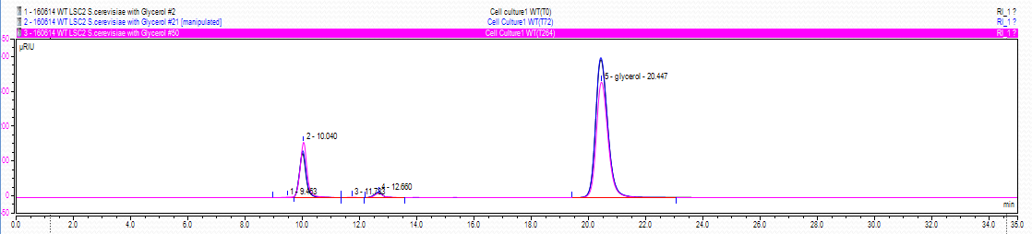
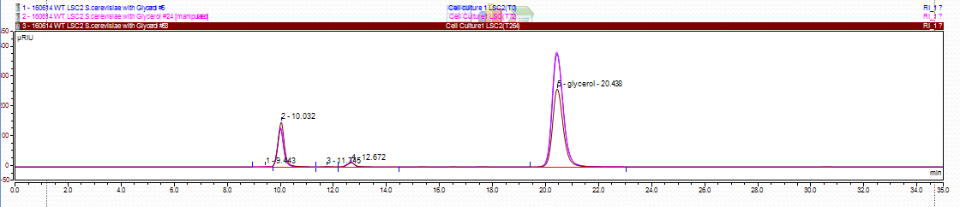
Significant amount of biomass produced, low secretion of organic acids

Slide 11
Metabolic engineering of S. cerevisiae
Substrate Utilization engineering:
Glycerol uptake from extracellular space: STL1(proton symporter) in plasma membrane
Glycerol transport inside Mitochondria:
GUT1-Glycerol Kinase
Introduction of Active transporter from other strains: P. tannophilus, Y. lipolytica, P. pastoris

Slide 12
Cofactor Balance:
Most optimal pathway through reductive TCA cycle
Reductive route = essentially anaerobic
Not a significant amount of excess ATP
Transformation to verify whether the oxidative route yields succinate: ΔLSC2 mutant

Slide 13
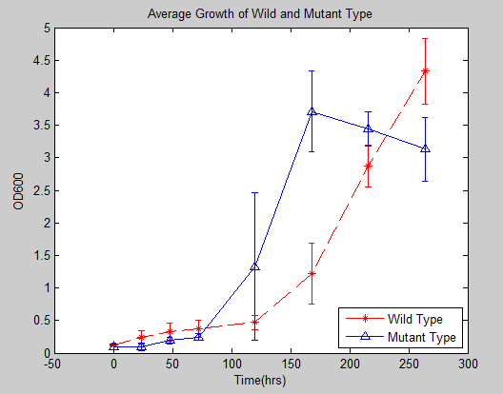
Growth of Wild and Mutant Type

Slide 14
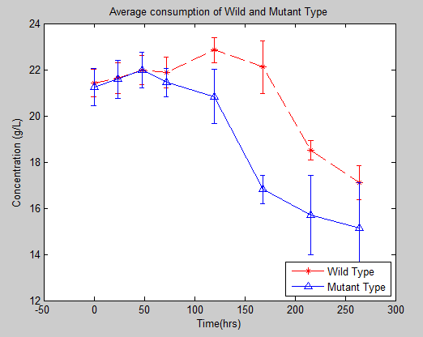
Glycerol Consumption of Wild and Mutant Type

Slide 15
Y. lipolytica: Pathway from Glycerol to Glyoxylate
Higher growth rate of wild type (NRRL Y-423) and PO1f strains on Glycerol
Higher consumption rate of Glycerol by Y. lipolytica
Safe-to-use organism with literatures available (information about growth medium, genome sequence, transformation protocol, etc)
Secretion of the variety of organic acids/ metabolites especially citric and isocitric acid

Slide 16
New HPLC method for separation of Glyoxylate, Pyruvate , AKG and Citrate
New pathway -> New metabolites -> Revision of HPLC method to separate glyoxylate, AKG and pyruvate
Separated metabolites with the aid of HPLC optimizer
New conditions given the constraints:
- Eluent: 10mM H2SO4
- Flow rate: 0.3ml/min
- Column Temperature: 36C
- Run time: 30min

Slide 17
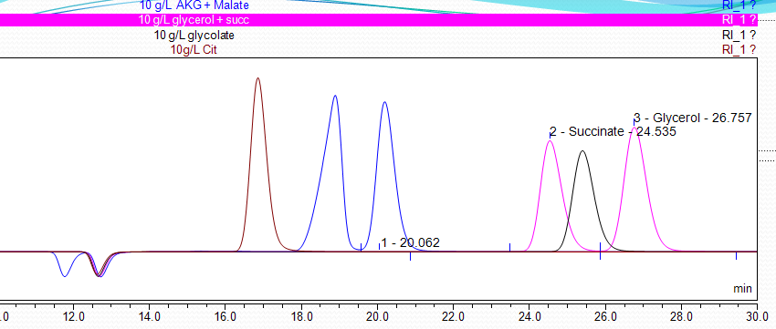
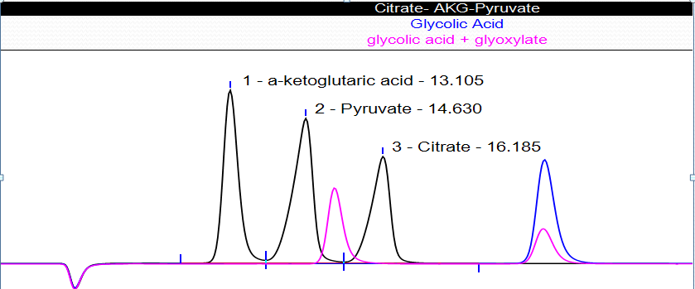

Slide 18
Verification of citric acid production from PO1f and NRRL Y-423:
Bioprocess Optimization: While growth conditions such as nitrogen source are limited and there is high concentration of carbon source(carbon shock) the cells tend to produce higher amount of citric acid.
Citric Acid Producing Medium(MP): YNB with 1g/L ammonium sulphate + 5% Glycerol
Growth Medium(MG): YNB with 3.5g/L ammonium sulphate + 2% Glycerol

Slide 19
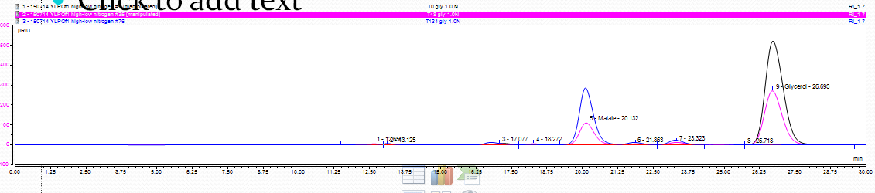
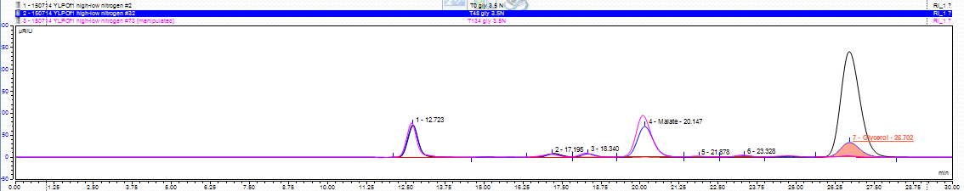
No citric acid produced from PO1f strain:
1) MP Glycerol 2) MG Glycerol

Slide 20
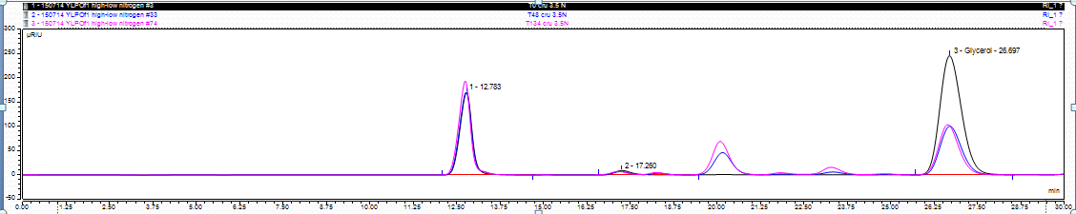
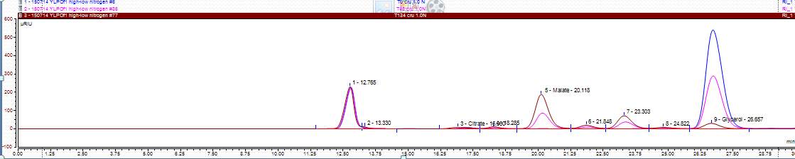
1) MP Crude 2)MG Crude

Slide 21
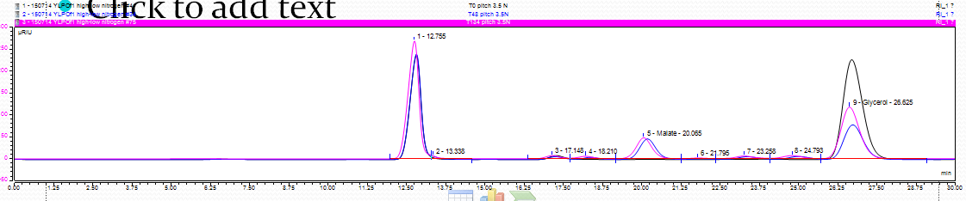
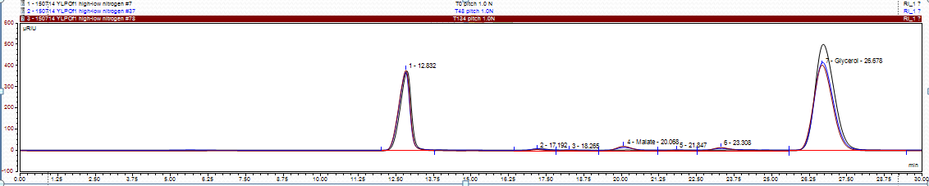
1)MP Pitch 2)MG Pitch

Slide 22
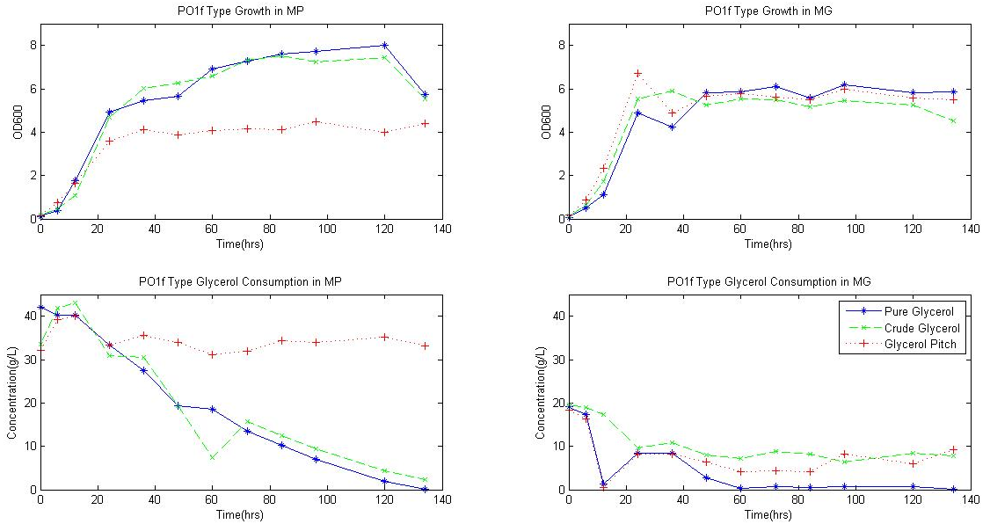
Growth on Glycerol and Glycerol Consumption of PO1f strain

Slide 23
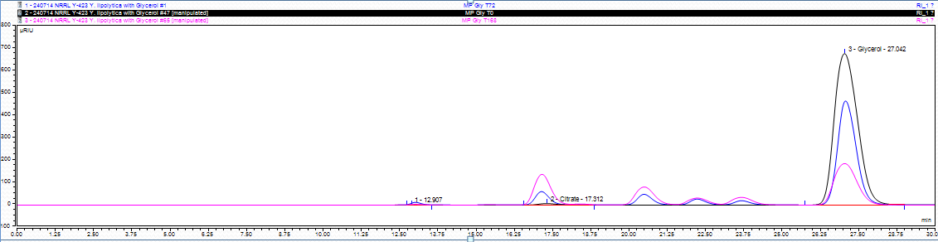
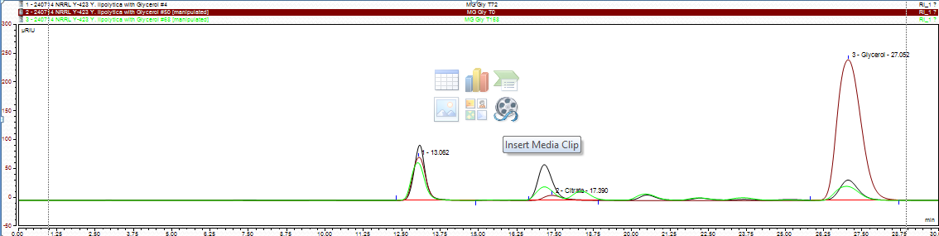
Citric acid produced from NRRL Y-423 strain:
1)MP Glycerol 2)MG Glycerol

Slide 24
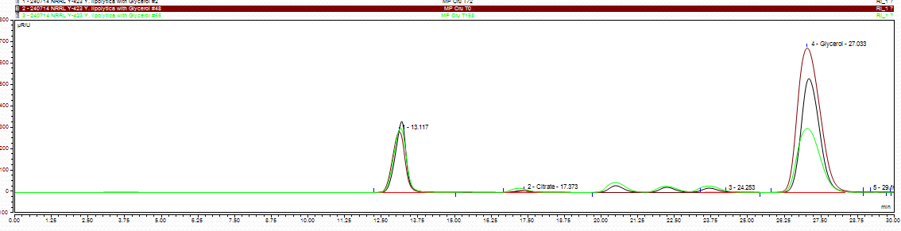
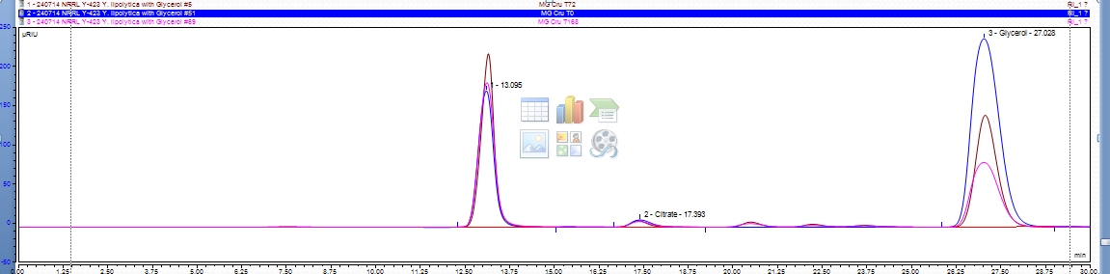
1)MP Crude 2)MG Crude

Slide 25
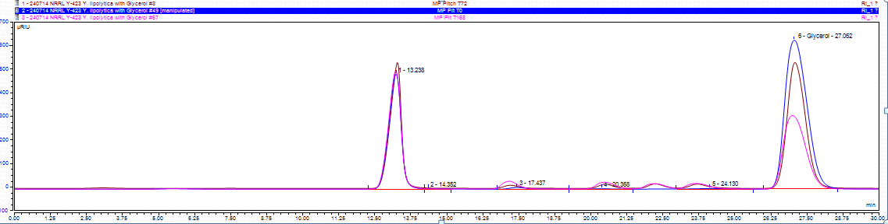
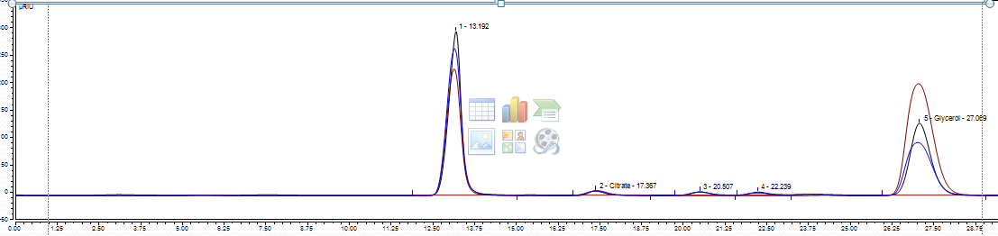
1)MP Pitch 2)MG Pitch

Slide 26
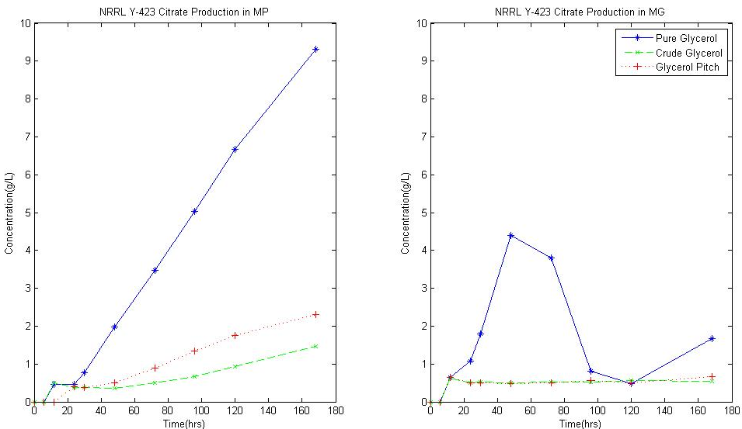
Citric acid Production in MP and MG Media

Slide 27
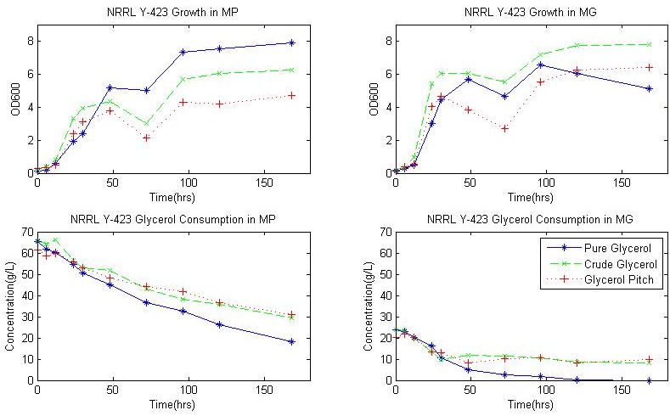
Growth on Glycerol and Glycerol Consumption of NRRL Y-423 Strain:

Slide 28
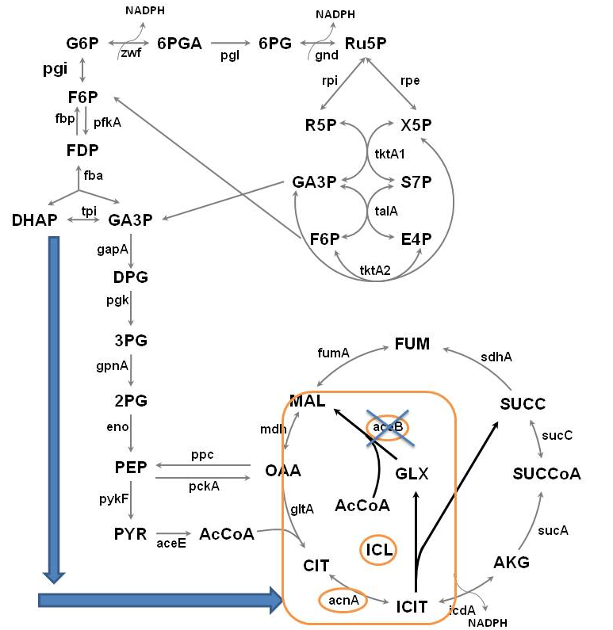
Citrate to Glyoxylate:
Citrate -> Isocitrate:
ACN(aconitase) overexpression
isocitrate -> Glycolate:
ICL (isocitrate lyase) overexpression
Glycolate -> Glyoxylate: YcdW (glyoxylate reductase) overexpression from E.coli GLYR1
glyoxylate ->malate: Malate synthase deletion

Slide 29
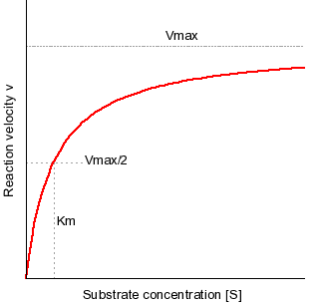
Separation of citrate and isocitrate
Using enzyme-based assay:
1)The enzyme isocitrate dehydrogenase is added to a solution of isocitrate.
2)The concentration of NADP+ obtained at 450nm after 30mins
3)Rate of NADP production versus the known concentration of substrate(isocitrate) is used as standard curve for measuring isocitrate concentration

Slide 30
To do:
Test the separation of isocitrate and citrate
Toxicity level of glycolate on Y. lipolytica
The effect of Malate synthase deletion, CAN, YcdW and ICL1 overexpression on isocitrate and glyoxylate yield

